Slide 1
Chapter 18
Creating a Single-Page App in React Using React Router

Slide 2
Objectives
Building Our Single-Page App
Using React Router
It’s the Little Things
Fixing Our Routing
Adding Some CSS
Highlighting the Active Link

Slide 3
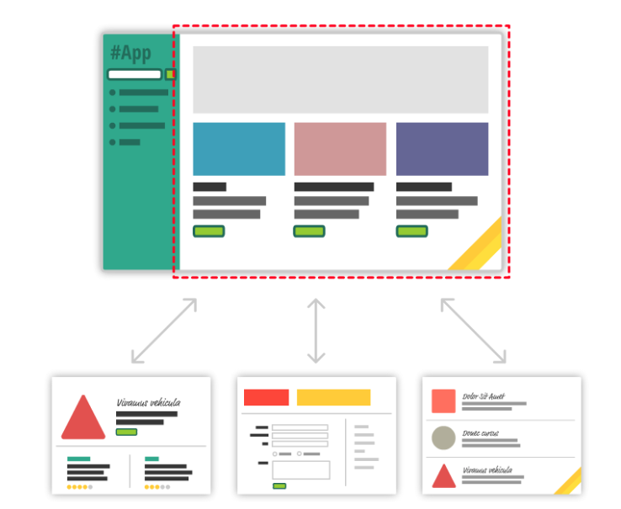
Building Our Single-Page App
When you are loading content inline, things get a little challenging. The hard part is not loading the content itself. That is relatively easy. The hard part is making sure that single-page apps behave in a way that is consistent with what your users are used to. More specifically, when users navigate your app, they expect that:
The URL displayed in the address bar always reflects the thing that they are viewing.
They can use the browser's back and forward buttons...successfully.
They can navigate to a particular view (aka deep link) directly using the appropriate URL.

Slide 4
React Routes
Notes:
Session: Ghi số thứ tự session trong môn học
Session Name: ghi tên của session sẽ dạy

Slide 5
Introduction
React Router keeps your UI in sync with the URL.
It has a simple API with powerful features like lazy code loading, dynamic route matching, and location transition handling built right in. Make the URL your first thought, not an afterthought.

Slide 6
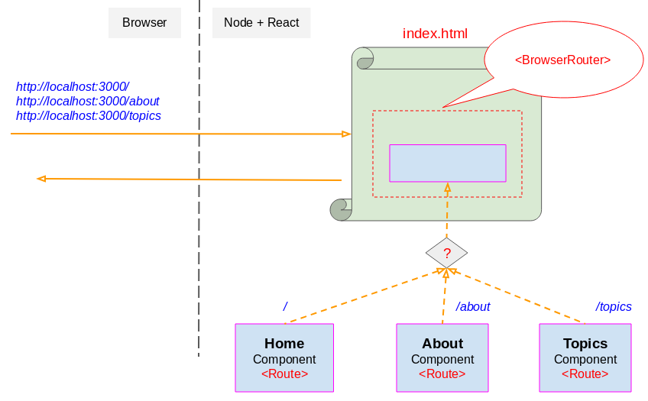
Introduction

Slide 7
React-router
React-router hosts the core components for routing for React applications
React-router-dom provides browser specific components for routing web apps and react-router-native provides specific components for react-native or mobile apps created with React Native.
So you should either install react-router-dom or react-router-native as both export their corresponding environments components plus what react-router exports.

Slide 8
Installation
Since we are building a web application not a native mobile app we need to install react-router-dom package, so inside your React project run the following command using your terminal (Linux or MAC) or command prompt (Windows)
npm install --save react-router-dom

Slide 9
<Router>
The common low-level interface for all router components. Typically apps will use one of the high-level routers instead:
<BrowserRouter><HashRouter><NativeRouter>
The most common use-case for using the low-level <Router> is to synchronize a custom history with a state management lib like Redux or Mobx.
import { Router } from 'react-router' import createBrowserHistory from 'history/createBrowserHistory' const history = createBrowserHistory() <Router history={history}> <App/> </Router>

Slide 10
<Router>
history: object
A history object to use for navigation.
children: node
A single child element to render.
<Router><App /></Router>
import createBrowserHistory from 'history/createBrowserHistory' const customHistory = createBrowserHistory() <Router history={customHistory}/>

Slide 11
< Route >
The < Route > component is one of the most useful components of React Router v4 and the idea behind it is simple, wherever you want to render something when only there is a match with the location's path you can use a Route component.
Using component:
<Route exact path="/" component={HomePage} />
Will render the HomePage component when browser's location path matches exactly /.

Slide 12
URL/Path/Route Parameters
Usually there are variable parts of the pathname used to pass information between diffrent routes of an application so how do we capture these variables and pass them to components? We can just append the name to be used for the variable plus a colon
<Route path="/:param1" component={Home}/> const Home = ({ match }) => ( <div> <h1> Parameter 1 : {match.params.param1}</h1> </div> )

Slide 13
<Prompt>
Used to prompt the user before navigating away from a page. When your application enters a state that should prevent the user from navigating away (like a form is half-filled out), render a <Prompt>.
message: string
The message to prompt the user with when they try to navigate away.
<Prompt message="Are you sure you want to leave?" />
import { Prompt } from 'react-router' <Prompt when={formIsHalfFilledOut} message="Are you sure you want to leave?" />

Slide 14
<Prompt>
message: func
Will be called with the next location and action the user is attempting to navigate to. Return a string to show a prompt to the user or true to allow the transition.
when: bool
Instead of conditionally rendering a <Prompt> behind a guard, you can always render it but pass when={true} or when={false} to prevent or allow navigation accordingly.
<Prompt when={formIsHalfFilledOut} message="Are you sure?" />
<Prompt message={location => location.pathname.startsWith("/app") ? true : `Are you sure you want to go to ${location.pathname}?` } />

Slide 15
<Redirect>
Rendering a <Redirect> will navigate to a new location. The new location will override the current location in the history stack, like server-side redirects (HTTP 3xx) do.
to: string
The URL to redirect to. Any valid URL path that path-to-regexp@^1.7.0understands. All URL parameters that are used in to must be covered by from.
<Redirect to="/somewhere/else" />
import { Route, Redirect } from 'react-router' <Route exact path="/" render={() => ( loggedIn ? ( <Redirect to="/dashboard"/> ) : ( <PublicHomePage/> ) )}/>

Slide 16
<Redirect>
to: object
A location to redirect to. pathname can be any valid URL path that.
The state object can be accessed via this.props.location.state in the redirected-to component. This new referrer key (which is not a special name) would then be accessed via this.props.location.state.referrer in the Login component pointed to by the pathname '/login'
<Redirect to={{ pathname: "/login", search: "?utm=your+face", state: { referrer: currentLocation } }} />

Slide 17
<Redirect>
from: string
This can only be used to match a location when rendering a <Redirect> inside of a <Switch>. See <Switch children> for more details.
<Switch> <Redirect from='/old-path' to='/new-path'/> <Route path='/new-path' component={Place}/> </Switch> // Redirect with matched parameters <Switch> <Redirect from='/users/:id' to='/users/profile/:id'/> <Route path='/users/profile/:id' component={Profile}/> </Switch>

Slide 18
<Redirect>
exact: bool
Match from exactly; equivalent to Route.exact.
push: bool
When true, redirecting will push a new entry onto the history instead of replacing the current one.
<Redirect push to="/somewhere/else" />

Slide 19
<Redirect>
to: string
The URL to redirect to. Any valid URL path that path-to-regexp@^1.7.0understands. All URL parameters that are used in to must be covered by from.
<Redirect to="/somewhere/else" />
to: object
A location to redirect to. pathname can be any valid URL path that path-to-regexp@^1.7.0 understands.
<Redirect to={{ pathname: "/login", search: "?utm=your+face", state: { referrer: currentLocation } }} />

Slide 20
<Switch>
Renders the first child <Route> or <Redirect> that matches the location.
How is this different than just using a bunch of <Route>s?
<Switch> is unique in that it renders a route exclusively. In contrast, every <Route> that matches the location renders inclusively. Consider this code:
import { Switch, Route } from 'react-router' <Switch> <Route exact path="/" component={Home}/> <Route path="/about" component={About}/> <Route path="/:user" component={User}/> <Route component={NoMatch}/> </Switch>

Slide 21
Understanding and Using Links
A Link component takes a to property which tells React Router the destination to navigate to.
The to prop can either take a string or a location (pathname, hash, search, and state) object
import { Link } from 'react-router-dom' const Nav = () => ( <Link to='/'>Home</Link> )
<Link to={ { pathname: '/me', search: '?sort=asc', hash: '#hash', state: { fromHome: true } } } />

Slide 22
< Link > vs < NavLink >
NavLink is a subclass of Link which adds styling information to the rendered element(s), for example:
import { NavLink } from 'react-router-dom' <NavLink to="/me" activeStyle= activeClassName="selected">My Profile</NavLink>

Slide 23
Conclusion
By now, we've covered a good chunk of the cool functionality React Router has for helping you build your SPA.
This doesn't mean that there aren't more interesting things for you to take advantage of.
Our app was pretty simple with very modest demands on what routing functionality we needed to implement.
There is a whole lot more that React Router provides (including variations of APIs for what you've seen here), so if you are building a more complex single-page app than what we've looked at so far, you should totally spend an afternoon taking a look the full React Router documentation and examples.

